Slide 1
Simple Interest – Rearranging Simple Interest Formula
Miss Lum
Year 11 Essentials

Slide 2
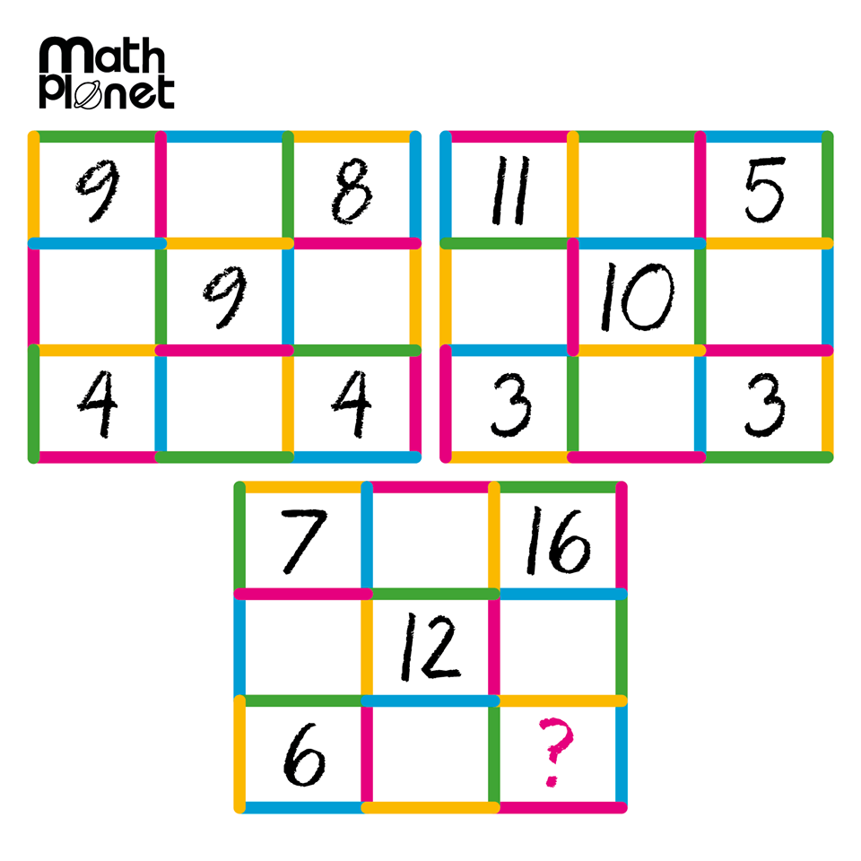
Mental Warm Up
Mental warm up.

Slide 3
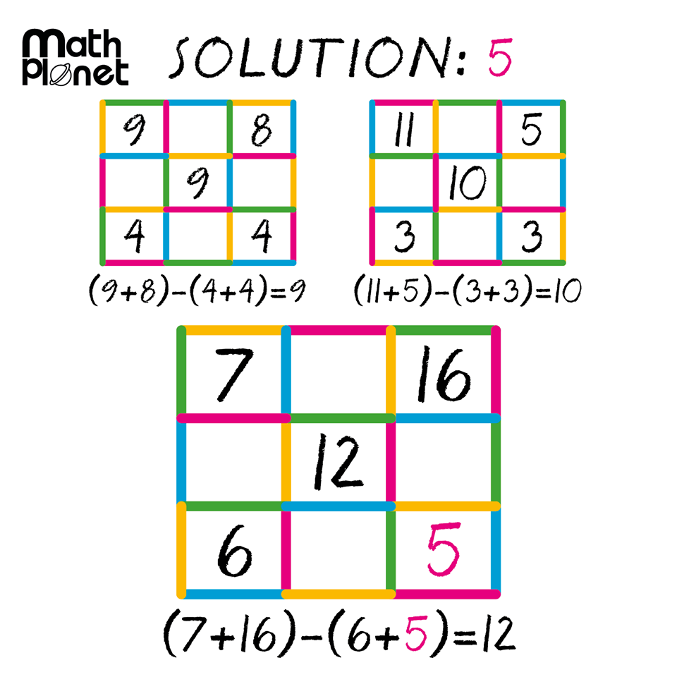

Slide 4
24
7
30
24
7
30
Simple Interest Continued
Date: 03/09/2018
EQ – How do you calculate for the other variables in the simple interest formula?
Joe wants to borrow $2000 from a bank to buy a new car. He will take 2 years to pay the money back, and the bank’s interest rate is 8% per annum (per year).
How much simple interest does he pay?
How much does he pay altogether?
When solving word problems you need to list all your information systematically.
P =
R =
T =

Slide 5
24
7
30
24
7
30
Simple Interest Continued
Date: 03/09/2018
EQ – How do you calculate for the other variables in the simple interest formula?
Susie borrows $4500 for a holiday. She expects to pay it off after 18 months. The bank charges 9% per annum interest.
How much interest does Susie pay?
How much does she pay altogether?
When solving word problems you need to list all your information systematically.
P =
R =
T =

Slide 6



24
7
30
24
7
30
Simple Interest Continued
Date: 03/09/2018
EQ – How do you calculate for the other variables in the simple interest formula?
Whatever is being solved for in the equation
What is the subject?
In this equation simple interest is the subject but what if we wanted to find the rate? (or principal amount or time)
How do we get a different subject?
We need to re-arrange the equation using back-tracking
Backtracking uses opposite operations to find the unknown.
Opposite Operations
Addition and Subtraction
Multiplication and Division
I = PRT
We want to get P by itself. What operation is happening to P?
Make P the subject of the equation
$$÷RT$$
$$÷RT$$
How do we undo multiplication? Division
$\frac{I}{RT}=P$
We have to do the EXACT same thing to both sides to keep the equation BALANCED

Slide 7
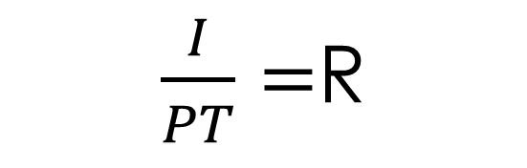
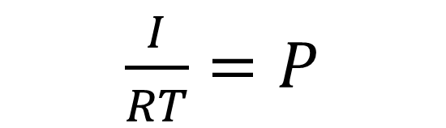


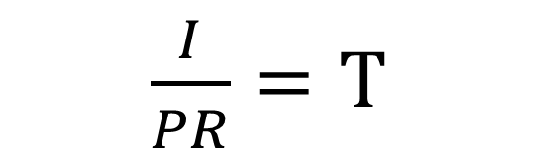




24
7
30
24
7
30
Simple Interest Continued
Date: 03/09/2018
EQ – How do you calculate for the other variables in the simple interest formula?
Make P the subject of the equation
I = PRT
We want to get P by itself. What operation is happening to P?
$$÷RT$$
$$÷RT$$
$\frac{I}{RT}=P$
How do we undo multiplication? Division
We have to do the EXACT same thing to both sides to keep the equation BALANCED
Make R the subject of the equation
I = PRT
$$÷PT$$
$$÷PT$$
$\frac{I}{PT}=$R
Make T the subject of the equation
I = PRT
$$÷PR$$
$$÷PR$$
$\frac{I}{PR}=T$

Slide 8
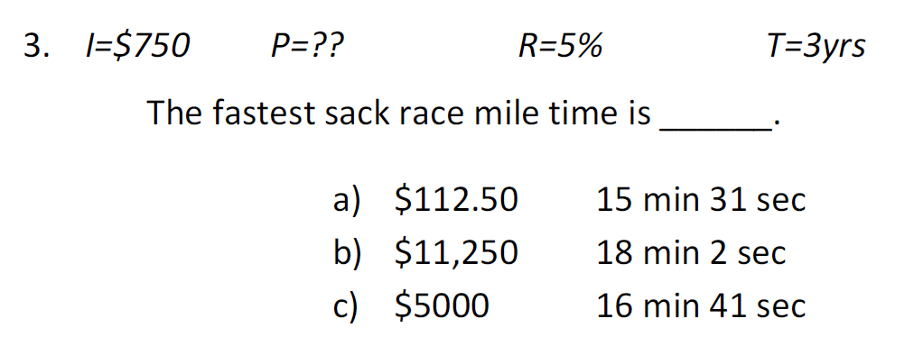

Slide 9
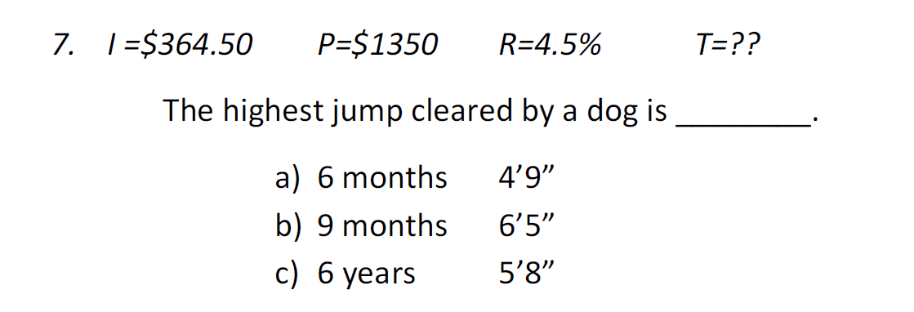

Slide 10
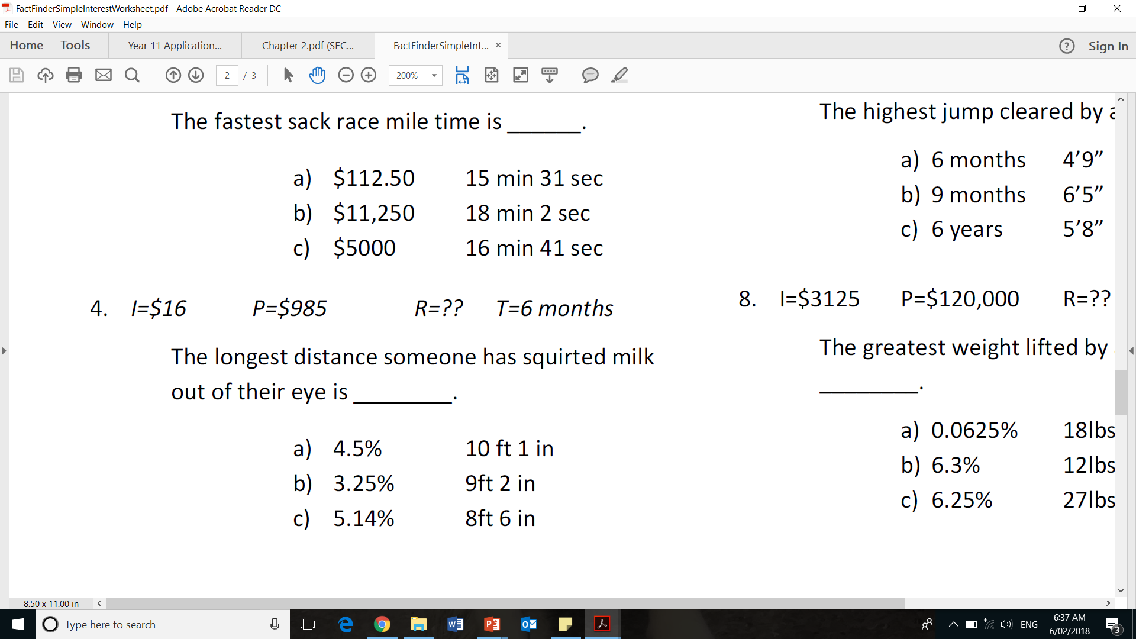

Slide 11
